Slide 1

CMR TECHNICAL CAMPUS
Department of Computer Science and Engineering
2020-2024
MINI PROJECT REVIEW
BATCH NO:13
PHISHING WEBSITE DETECTION USING ML
Presented by:
N.Sowmya 207R1A05A3
V.Chidrup 207R1A05B6
Ch.Kushal 207R1A0588
Under the guidance of :
Saba Sultana
(Assistant professor)

Slide 2

ABSTRACT
Phishing attack is a simplest way to obtain sensitive information like username, password and bank account details from innocent users.
Aim of the project is to detect phishing URLs using SVM and light GBM algorithms.
In this project, ML algorithms are trained using large datasets of both legitimate and phishing websites.
Phishing is a type of cyber-attack where an attacker creates a fake website.

Slide 3
EXISTING SYSTEM
There are various existing systems for phishing website detection using Machine Learning. Here are some examples:
PhishDef
PhishGuard
PhishNet

Slide 4

DISADVANTAGES OF EXISTING SYSTEM
Limited training data
False positives
Black box models
Overfitting

Slide 5
PROPOSED SYSTEM
This project uses SVM, LightGBM and features of the domain name to identify phishing websites and maintain security.
The proposed model is first used to extract features of the domain name of the given website, including character-level features and information on the domain name.
The extracted features are filtered to improve the model’s accuracy and are subsequently used for classification.
The proposed model is suitable for the real-time detection of many phishing websites.

Slide 6
ADVANTAGES OF PROPOSED SYSTEM
There are several advantages to the proposed system of phishing website detection using machine learning:
Increased accuracy
Scalability
Flexibility
Cost-effectiveness

Slide 7

SYSTEM CONFIGURATION
HARDWARE REQUIREMENTS:
Processor : Pentium IV or higher
Ram : 256MB
Hard Disk : minimum 512MB
SOFTWARE REQUIREMENTS:
Python
Django
MySQL
WampServer
Operating Systems supported: Windows XP,7,8

Slide 8
NOVELTY OF PROJECT
Use of machine learning techniques to detect phishing URLs.
Another aspect of novelty in such projects is the use of techniques for feature extraction and data analysis, which can help identify differences between legitimate and phishing websites.
The phishing detection model provides a scalable, automated, and accurate solution to a growing problem that affects millions of users worldwide.
This project can help prevent financial losses, protect sensitive information, and safeguard online identities from phishing attacks.

Slide 9
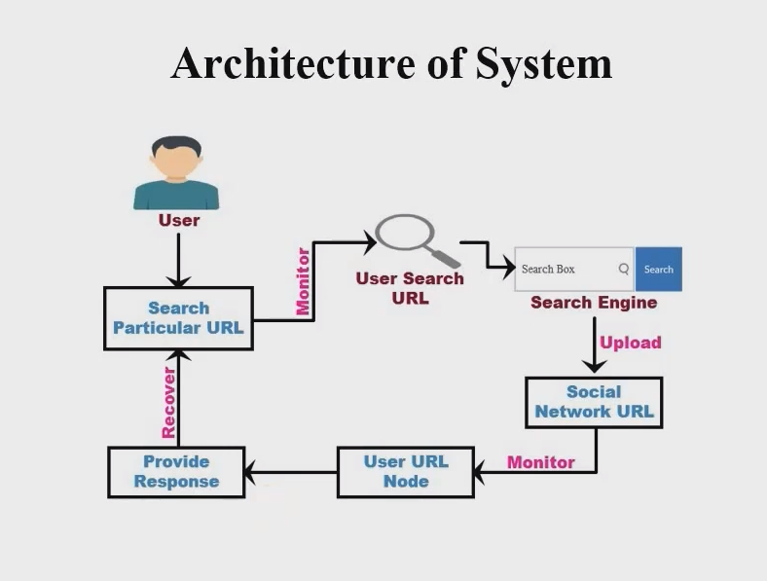

Slide 10
MODULES
There are several modules that can be used to develop phishing website detection project. Here are some key modules:
Libraries Data manupulation and scientific computing.
Machine learning frameworks.
Phishing and valid url dataset.
Phishing detection.

Slide 11
UML DIAGRAMS
Use case Diagram
a. System b. User

Slide 12
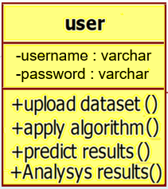
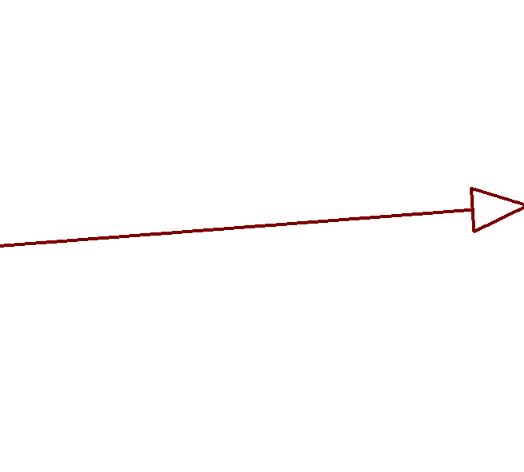
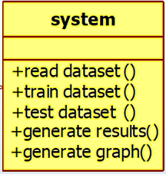
Class Diagram

Slide 13
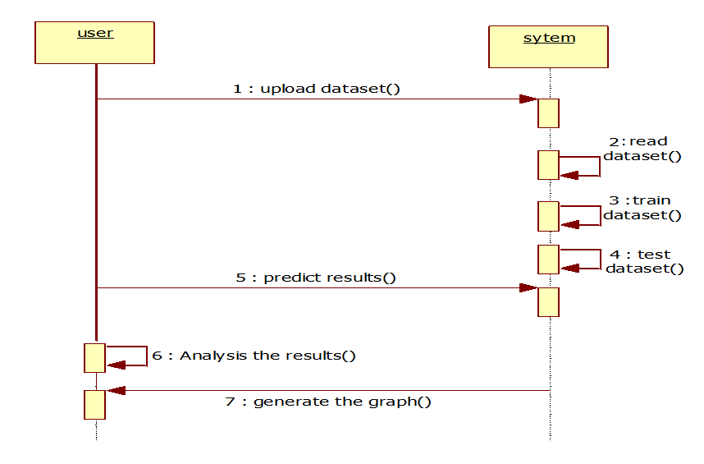
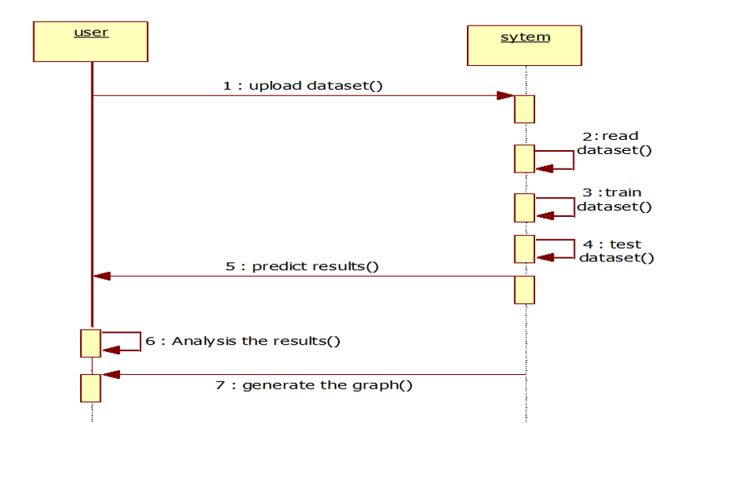
Sequence Diagram

Slide 14
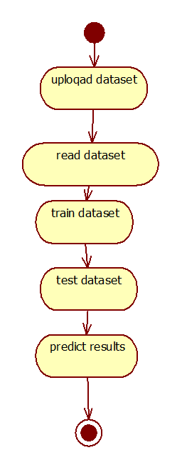
Activity Diagram

Slide 15
Sample Code
def RunSVM(request):
if request.method == 'GET':
global precision, recall, fscore, accuracy
global X_train, X_test, y_train, y_test
precision = []
accuracy = []
fscore = []
recall = []
predict = svm_cls.predict(X_test)
acc = accuracy_score(y_test,predict)*100
p = precision_score(y_test,predict,average='macro') * 100
r = recall_score(y_test,predict,average='macro') * 100
f = f1_score(y_test,predict,average='macro') * 100
precision.append(p)
recall.append(r)
fscore.append(f)

Slide 16
accuracy.append(acc)
output = ""
output+='<tr><td><font size="" color="black">SVM</td>'
output+='<td><font size="" color="black">'+str(accuracy[0])+'</td>'
output+='<td><font size="" color="black">'+str(precision[0])+'</td>'
output+='<td><font size="" color="black">'+str(recall[0])+'</td>'
output+='<td><font size="" color="black">'+str(fscore[0])+'</td>'
ax = sns.heatmap(conf_matrix, xticklabels = LABELS, yticklabels = LABELS, annot = True, cmap="viridis" ,fmt ="g");
ax.set_ylim([0,2])
plt.title("SVM Confusion matrix")
plt.ylabel('True class')
plt.xlabel('Predicted class')
plt.show()
context= {'data':output}
return render(request, 'ViewOutput.html', context)

Slide 17
def RunLGBM(request):
if request.method == 'GET':
global precision, recall, fscore, accuracy
global X_train, X_test, y_train, y_test
predict = lgbm_cls.predict(X_test)
acc = accuracy_score(y_test,predict)*100
p = precision_score(y_test,predict,average='macro') * 100
r = recall_score(y_test,predict,average='macro') * 100
f = f1_score(y_test,predict,average='macro') * 100
precision.append(p)
recall.append(r)
fscore.append(f)
accuracy.append(acc)
output = ""
output+='<tr><td><font size="" color="black">SVM</td>'
output+='<td><font size="" color="black">'+str(accuracy[0])+'</td>'

Slide 18
output+='<td><font size="" color="black">'+str(recall[1])+'</td>'
output+='<td><font size="" color="black">'+str(fscore[1])+'</td>'
LABELS = ['Normal URL','Phishing URL']
conf_matrix = confusion_matrix(y_test, predict)
plt.figure(figsize =(6, 6))
ax = sns.heatmap(conf_matrix, xticklabels = LABELS, yticklabels = LABELS, annot = True, cmap="viridis" ,fmt ="g");
ax.set_ylim([0,2])
plt.title("Decision Tree Confusion matrix")
plt.ylabel('True class')
plt.xlabel('Predicted class')
plt.show()
context= {'data':output}
return render(request, 'ViewOutput.html', context)

Slide 19
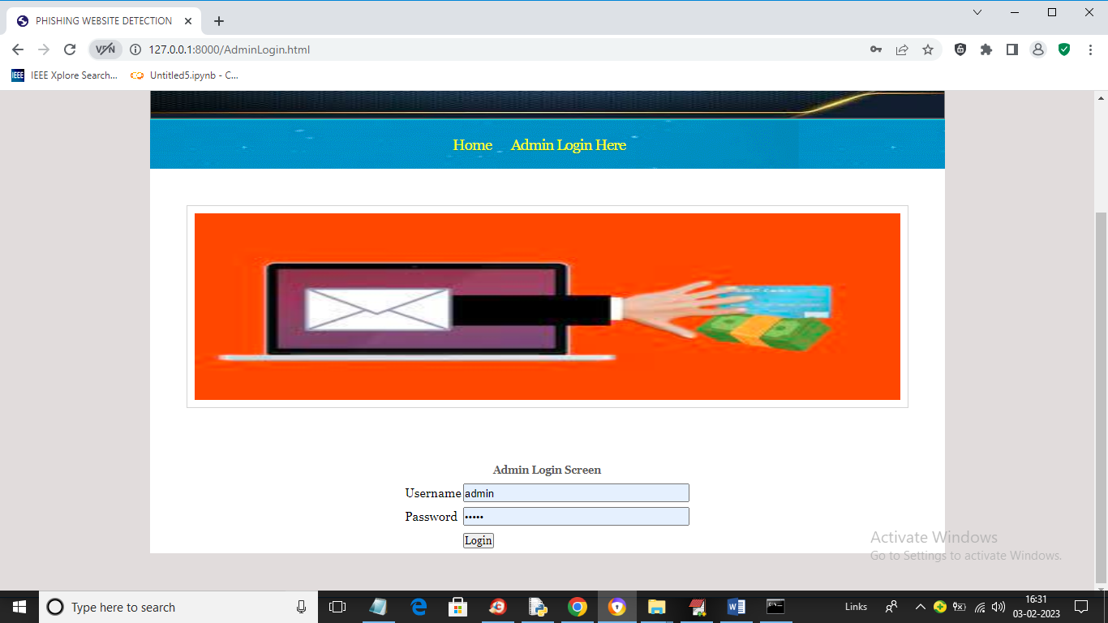
Results
Fig 1: Screen with Login Window

Slide 20
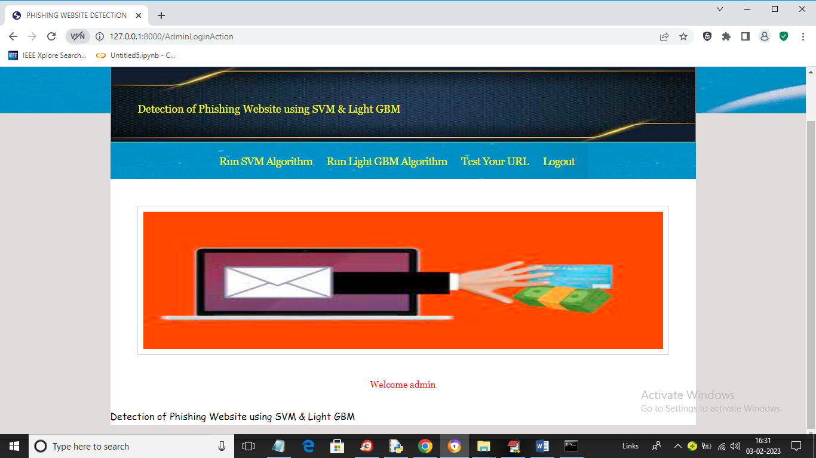
Fig 2: Screen with Home Page

Slide 21
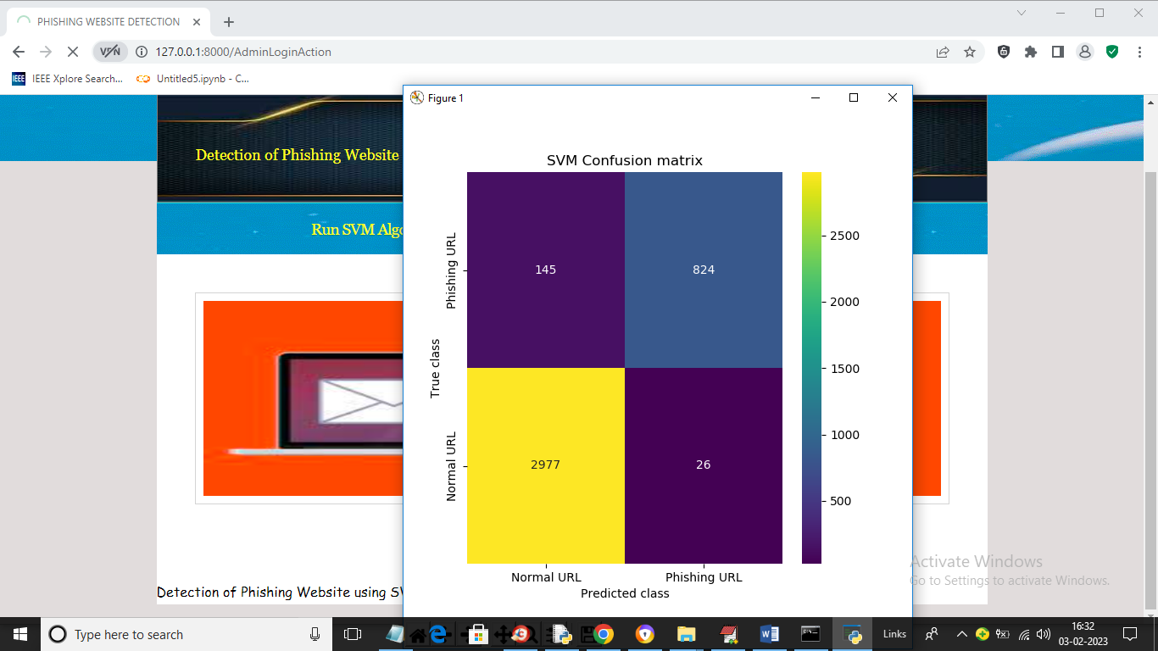
Fig 3: SVM Algorithm Confusion Matrix

Slide 22
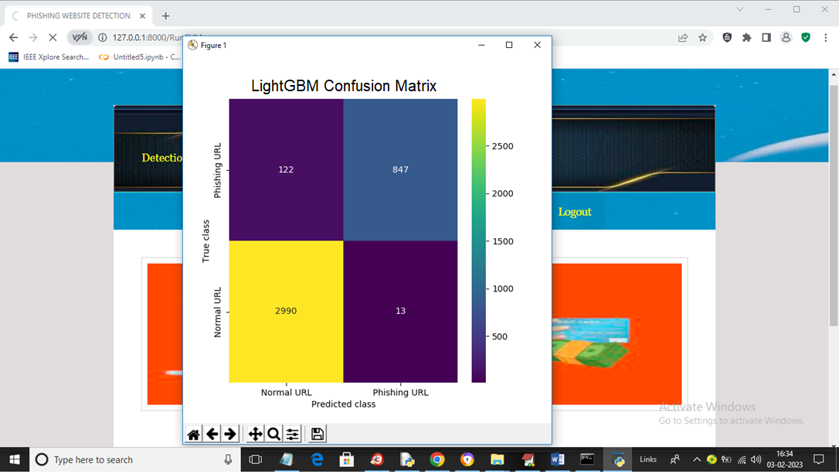
Fig 4: LightGBM Algorithm Confusion Matrix

Slide 23
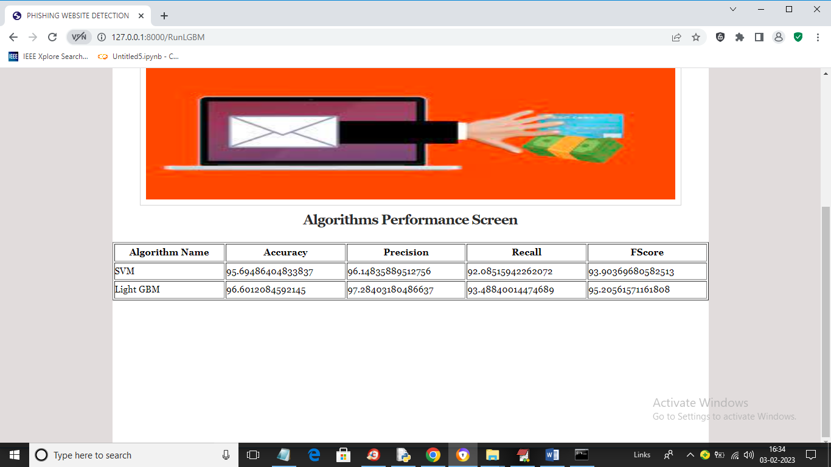
Fig 5: Algorithms performance screen

Slide 24
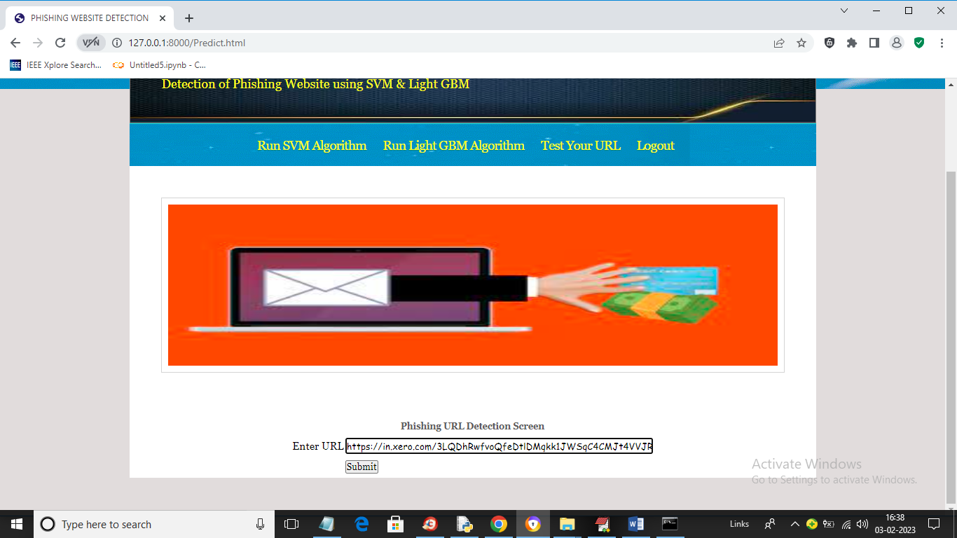
Fig 6: URL Detection Screen

Slide 25
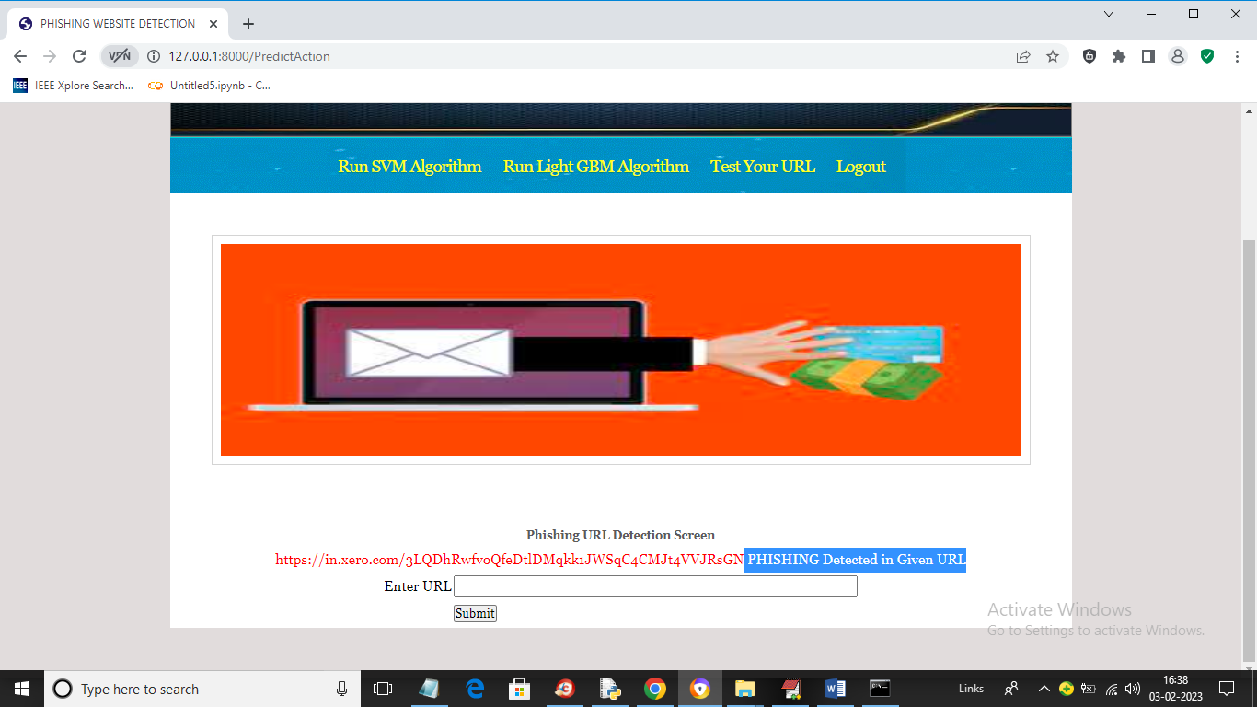
Fig 7: URL Detection Screen

Slide 26
CONCLUSION
In conclusion, a phishing website detection project using machine learning (ML) can provide a reliable and effective solution to the growing problem of phishing attacks.
This project can help prevent financial losses, protect sensitive information, and safeguard online identities from phishing attacks.
However, it is important to note that phishing attacks are constantly evolving and becoming more sophisticated, and ML-based detection systems may not always be foolproof.
Overall, a phishing website detection project using ML is a valuable contribution to the field of cybersecurity, providing a scalable and automated solution to a pervasive problem that affects millions of users worldwide.

Slide 27
FUTURE SCOPE
Hybrid Models
Real-time Detection
Cross-platform Compatibility
Global Threat Analysis
Collaboration with Cybersecurity Industry

Slide 28
REFERENCES
Ms. Sophiya Shikalgar, Mrs. Swati Narwane (2019), Detecting of URL based Phishing Attack using Machine Learning. (vol. 8 Issue 11, November – 2019)
Rashmi Karnik, Dr. Gayathri M Bhandari, Support Vector Machine Based Malware and Phishing Website Detection.
Arun Kulkarni, Leonard L. Brown, III2 , Phishing Websites Detection using Machine Learning (vol. 10, No. 7,2019)
R. Kiruthiga, D. Akila, Phishing Websites Detection using Machine Learning.
Ademola Philip Abidoye, Boniface Kabaso, Hybrid Machine Learning: A Tool to detect Phishing Attacks in Communication Networks. (vol. 11 No. 6,2020)

Slide 29
GITHUB LINK
https://github.com/chidrup29/Phishing-Website-Detection

Slide 30
THANK YOU

